Slide 1
SM-0
SM-1
SM-M
Threads on CUDA Cores
Threads on CUDA Cores
Threads on CUDA Cores
on GPU chip
Registers
Registers
Registers
PCI Express
Bus
Host Memory
L1
Shared Memory
L1
Shared Memory
L1
Shared Memory
L2
off GPU chip
Global Memory

Slide 2
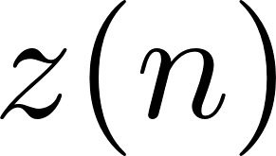

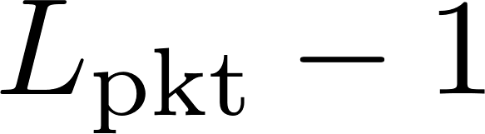

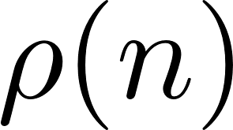
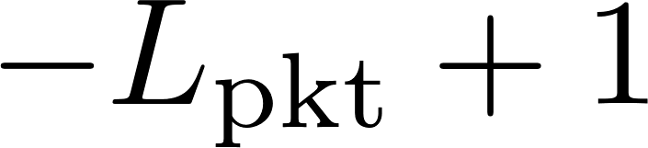
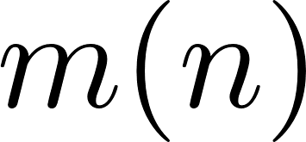
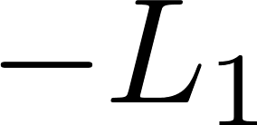
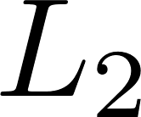

Slide 3

Preamble
Data
ASM
Data
Preamble
ASM
Data
Cyclic Prefix
ASM
Data
12672 samples

Slide 4
Estimators
GPU0
Preamble
Detector
Compute
MMSE
CMA
Iterations
CMAFilter
OQPSK
Demod
GPU0 to GPU1
Transfer
Compute
ZF
ZF Filter
OQPSK
Demod
MMSE
Filter
OQPSK
Demod
GPU1
GPU2
Resampling
Polyphase Filters
GPU1 to GPU2
Transfer
FDE1Filter
OQPSK
Demod
FDE2 Filter
OQPSK
Demod
GPU0 to Host
Transfer
CPU
Host to GPU0
Transfer
CPU to FPGA
Transfer
CPU
Acquire ADC Data
CPU
Synchronize

